Slide 1

Chapter 3
The Constant Failure Rate Model
Exponential Probability
Distribution
Hurry, come here! Chapter 3 is starting now. You don’t want to miss any of this.
Chapter 3
Notes:
One of the most frequently used reliability functions is based upon the exponential probability distribution. The exponential distribution is the first of several theoretical probability distributions that will be discussed. Perhaps because of its relative simplicity and ease of use, it was one of the first distributions to be applied to failure times. Any failure mode having a constant failure rate over time will have an exponential distribution.

Slide 2
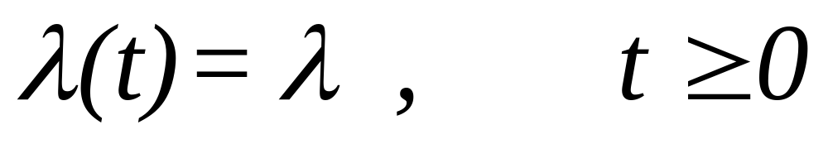
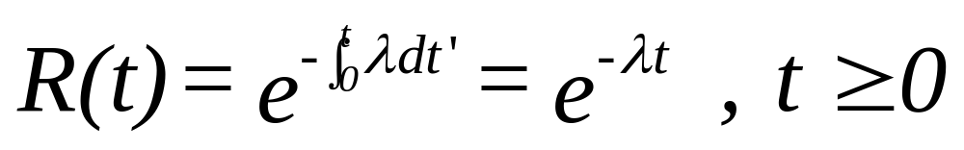
The Exponential Distribution
Let
Then
Chapter 3
Notes:
We derive the exponential distribution by starting with the assumption that the hazard rate function is constant (CFR) and equal to lambda. Certainly this is the simplest assumption that can be made concerning the functional form of the hazard rate function. Then using the relationship between the reliability function and the hazard rate function presented in Chapter 2, the exponential reliability function is obtained. Check and see if this function has the properties of a reliability function! You do recall what those properties are, don’t you?

Slide 3
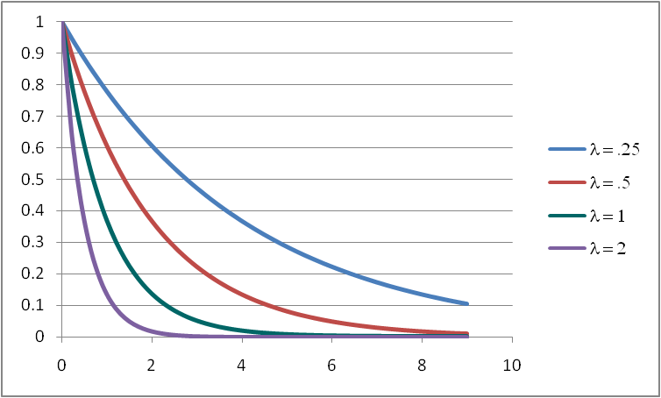
The Reliability Function
Chapter 3
Notes:
The reliability function is plotted for three different values of its parameter lambda. From the graph it can be seen that as lambda gets larger, the reliability as a function of time more quickly approaches zero.

Slide 4
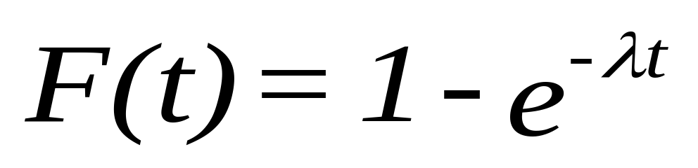
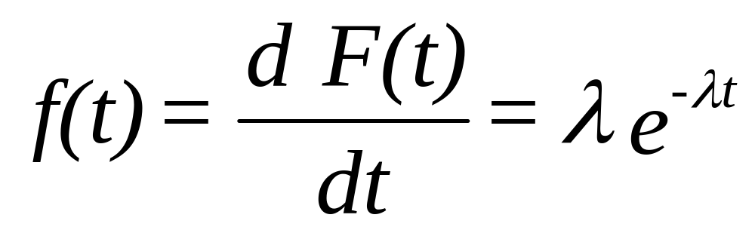
The CDF and PDF
Chapter 3
Notes:
The CDF and PDF are obtained using the relationships presented in Chapter 2. Test your understanding of these functions by convincing yourself that they obey the properties of a CDF and PDF.

Slide 5
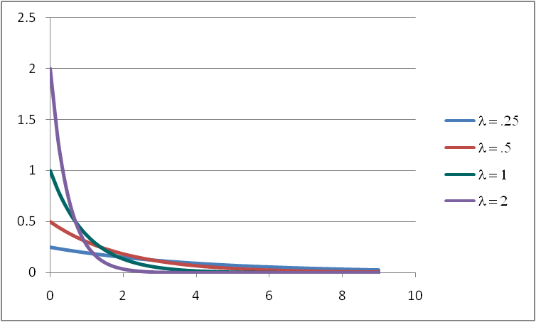
Probability Density Function (PDF)
Chapter 3
Notes:
The PDF provides the “shape” of the distribution. For the exponential, the distribution is skewed right with the mode always occurring at t = 0.

Slide 6
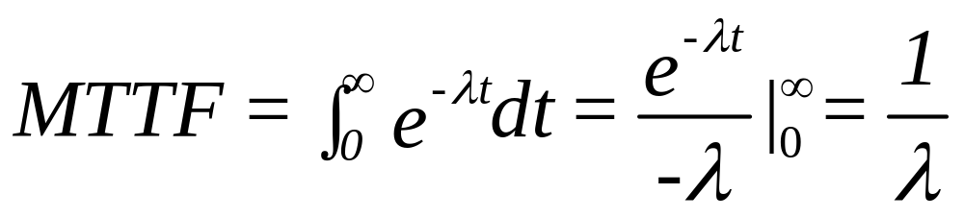
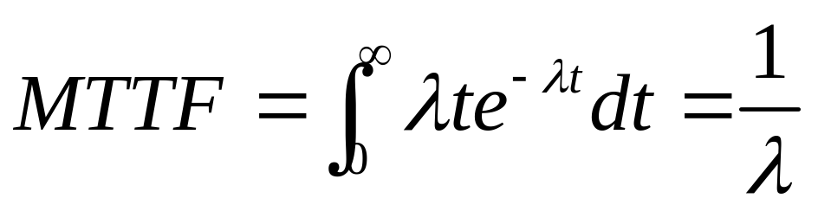
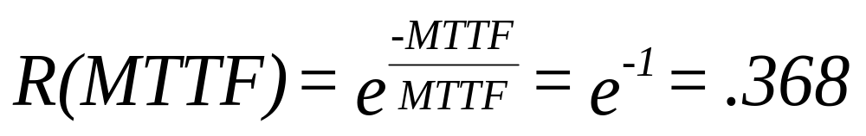
The MTTF
or
note that
Chapter 3
Notes:
Using the definitional form of the mean of a probability distribution, the MTTF is found to be the inverse of the (constant) failure rate. It is only for the exponential distribution that this true. The failure rate is failures per time unit (e.g. .01 failures per day) and the MTTF is time units to failure (100 days to failure). If we set t = MTTF and find R(t = MTTF), it will always be .368 for this distribution. Why? This suggests that only 36.8 percent of all units will survive beyond the MTTF. Finding the mean of the exponential is easier if we integrate the reliability function. As an exercise, try it.

Slide 7
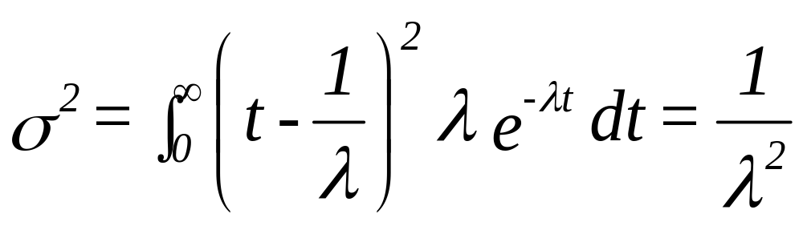

The Standard Deviation
Chapter 3
Notes:
The variance is found through integration. Interesting, the standard deviation is equal to the mean. What can be concluded from this? Perhaps, the more reliable a component (as measured by its MTTF), the more variability in failure times will be observed.

Slide 8
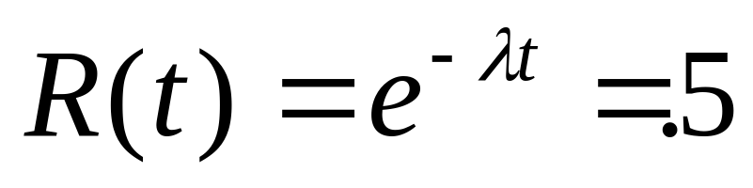
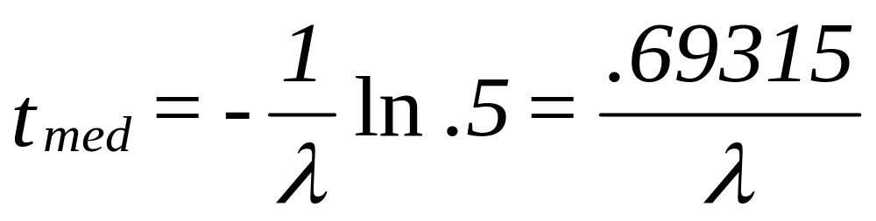
The Median Time to Failure
= .69315 MTTF
Chapter 3
Notes:
The median is easily derived and is always 69.315 percent of the mean. Of course only 50 percent of all components will survive beyond the median.

Slide 9
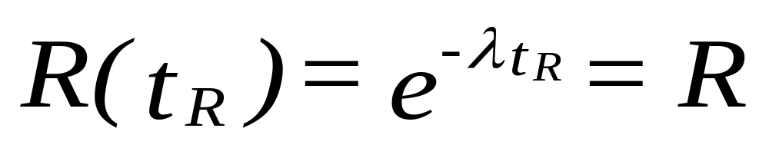

The Design Life
For a given reliability R, let
Chapter 3
Notes:
Solving for the design life is similar to solving for the median. In fact, it is just a generalization of the median isn’t it? What happens if R = .5 in the above formula?>

Slide 10

Example #1 - CFR model
An electrical transmission line has been tested and found to have a CFR of .001 defects per foot. Find:
a. R(100)
b. R(1000)
c. MTTF
d. Standard Deviation
e. t_{med}
f. 90 percent design life
Chapter 3
Notes:
It’s about time – an exercise for you to try. This should not be difficult. The answers follow.

Slide 11
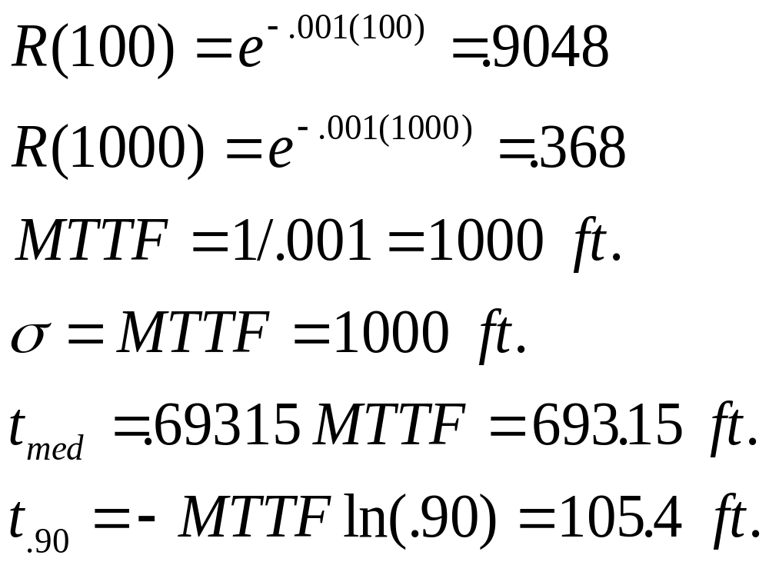
Example #1 - solution
Chapter 3
Notes:
You should have gotten the correct answers. If not, go back to the beginning, do not pass go, and do not collect any money.

Slide 12
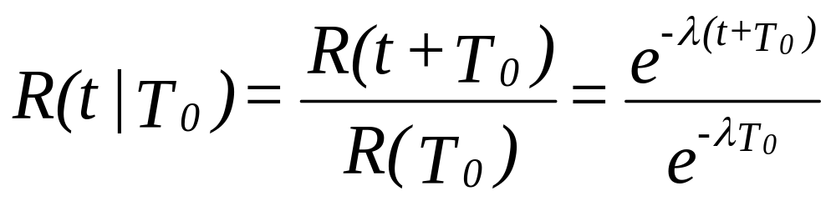
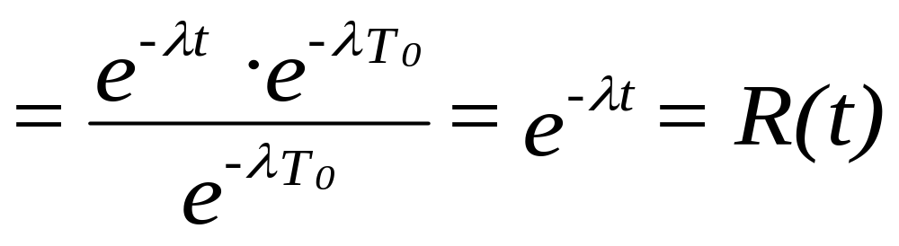
Memoryless Property
Chapter 3
Notes:
What about conditional reliability you ask! Here is an interesting result. The conditional reliability equals the unconditional reliability. This is just another manifestation of the “memoryless” property of the exponential distribution. This implies that if we have two components, one 2 years old (T₀ = 2); another 10 years old (T₀ = 10), the reliability that they will survive another 5 years (t = 5) is the same for both of them and is equal to R(5). The components do not age! Can you suggest some situations where this would be true?

Slide 13
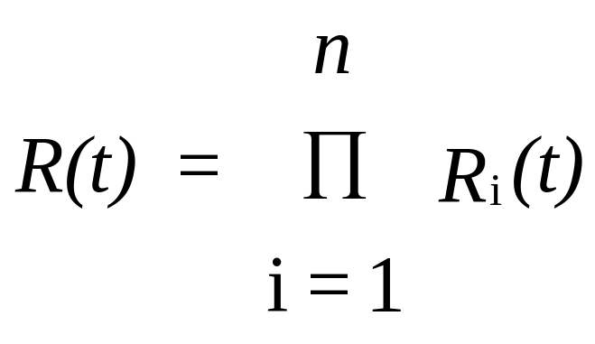
Failure Modes
R_{i}(t) is the reliability function for the ith failure mode,
then, assuming independence among the failure modes,
the system reliability, R(t) is found from
Chapter 3
Notes:
A failure mode is simply one manner in which a component can fail. Components may have several failure modes each having their own unique failure distribution. For example, a motor may fail due to a power surge or it may fail because of a short in the wiring. A complex system can have the failure of each of its components defined as a failure mode. The overall reliability of a component having several failure modes is simply the product of the reliability of each failure mode (assuming independence – no common cause).

Slide 14
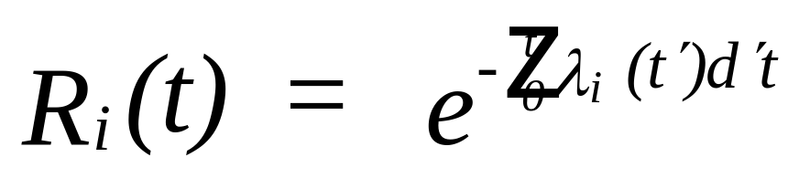
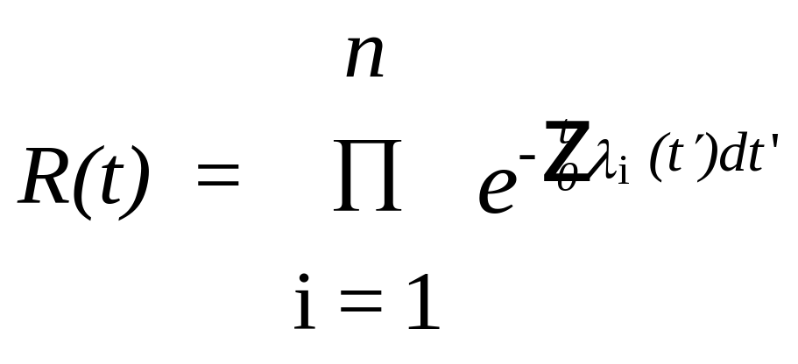
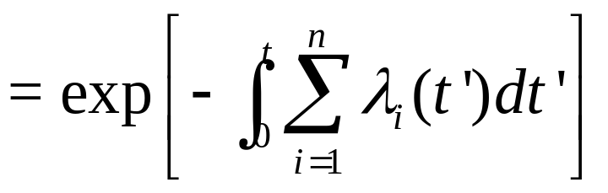
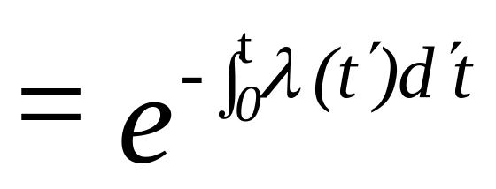
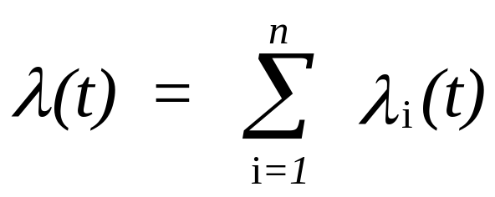
More on Failure Modes
Let
Then
where
Chapter 3
Notes:
Using one of our favorite formulae from Chapter 2, we reach the relatively simple result that the system or overall failure rate is the sum of all the individual failure rates. What could be easier than addition? You follow the derivation, right?

Slide 15
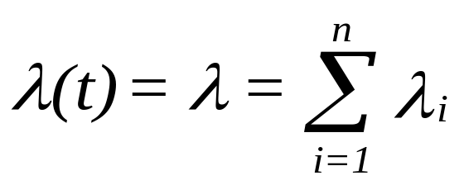
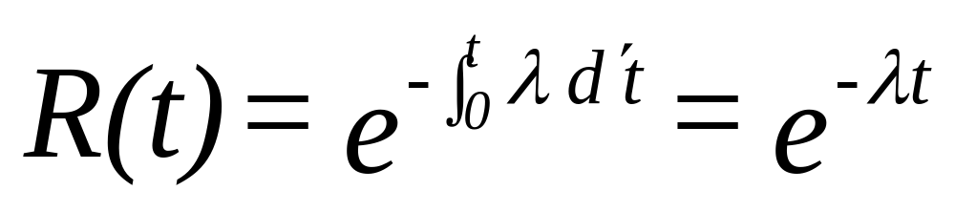
Failure Modes and CFR
If a system consists of n independent,
serially related components each with
CFR, then
and
Chapter 3
Notes:
Things get simpler if the failure rate or hazard rate function is constant for all failure modes. In this case the system failure rate is also constant (CFR) which then generates an exponential distribution. Serial related components or failure modes will be discussed some more in Chapter 5. However, for now, it simply means that if any component fails or failure mode occurs, the system will fail.

Slide 16

Example - Failure Modes
An engine tune-up kit consists of 3 parts each having CFRs (in failures per mile) of .000034, .000017, and .0000086.
Find the MTTF, median time to failure, standard deviation, and reliability of the tune-up kit at 10,000 miles.
Chapter 3
Notes:
Your turn!

Slide 17
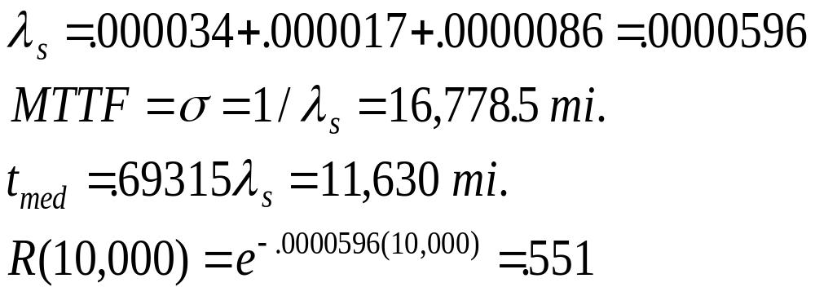

Example - solution
Chapter 3
Notes:
Ahhhhh, the answers.

Slide 18
Parts Count Approach
An integrated circuit board consists of the following components each having a CFR.
Component a-Failure Rate(10⁻⁵) b- Quantity (a) x (b)
Diodes, silicon .00041 10 .0041
Resistors .014 25 .3500
Capacitors .0015 12 .0180
Transformer .0020 2 .0040
Relays .0065 6 .0390
Inductive devices .0004 12 .0048
total .4199 x 10⁻⁵
Therefore R_{sys}(t) = e^{- .000004199 t} and MTTF = 1/.4199 x 10⁵
Chapter 3
Notes:
A military specification on the prediction of electronic components defines a parts count approach to finding system reliability. It is based upon the assumption that all components are CFR and that the failure rates can be summed to get the system failure rate. Electronic components are more likely to experience CFR than mechanical components. Why?

Slide 19
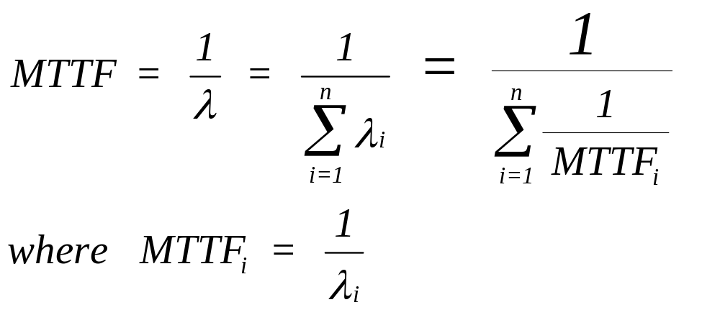
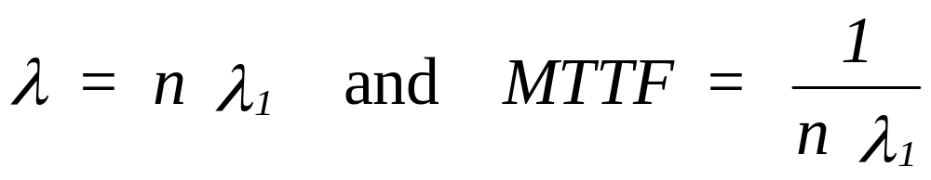
All Failure Modes are CFR
If all components have identical failure rates, then:
Chapter 3
Notes:
Things can get simpler (I know, it is hard to believe) if all failure modes or components have the same identical constant failure rate. Give some examples where this would be the case. In general for CFR components, the system MTTF is equal to the inverse of the sum of the component MTTF inverses. Of course, all we are doing here is adding the failure rates.

Slide 20
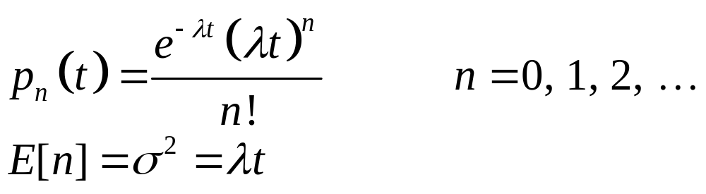
3.5 Poisson Process
If a component having a constant failure rate λ is immediately repaired or replaced upon failing, the number of failures observed over a time period t has a Poisson distribution. The probability of observing n failures in time t is given by the Poisson probability mass function p_{n}(t):
Chapter 3

Slide 21
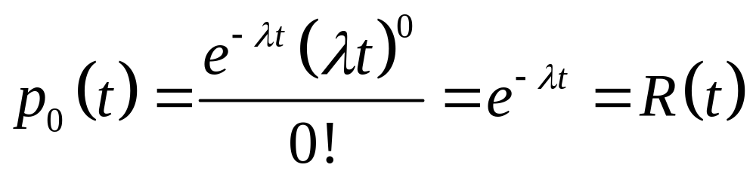
The Poisson and Exponential
Chapter 3

Slide 22
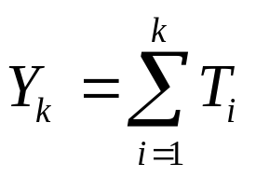
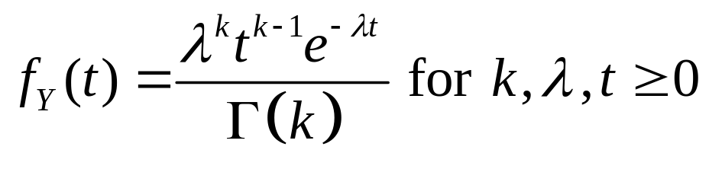
The Gamma Distribution
LetT_{i} = time between failure i – 1 and failure i having an exponential distribution with parameter λ.
Y_{k} = the time of the kth failure. The sum of k independent exponential random variables has a gamma distribution with parameters λ and k.
If k is an integer (i.e. the Erlang distribution),
Chapter 3

Slide 23
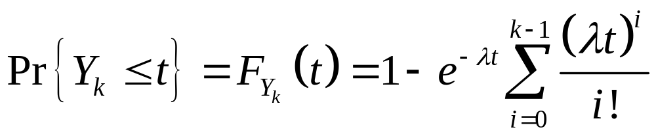
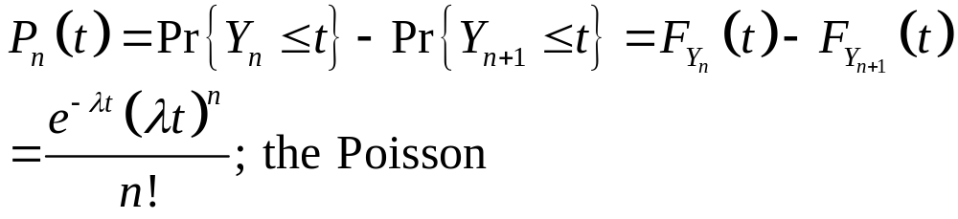
The Gamma Distribution
The CDF is the probability that the k^{th} failure will occur by time t.
The mean value for Y_{k} is k/λ, and the variance is k/λ².
The mode is (k – 1)/λ.
Chapter 3

Slide 24
Related Failure Distributions
Random Variable | Distribution | Parameter(s)
T, time to failure | Exponential | λ
Y_{k}, time of the k^{th} failure | Gamma (Erlang) | λ, k
N, number of failures in time t | Poisson | λ
Chapter 3

Slide 25
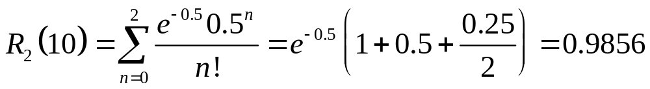
EXAMPLE 3.9
A specially designed welding machine has a nonrepairable motor with a constant failure rate of 0.05 failures per year. The company has purchased two spare motors. If the design life of the welding machine is 10 yr, what is the probability that the two spares will be adequate?
λt = 0.05(10) = 0.5.
Chapter 3

Slide 26
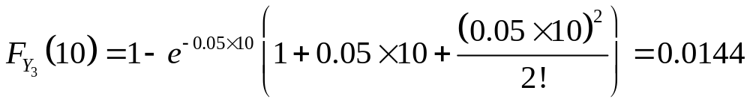
EXAMPLE 3.9
Let Y₃ be the time of the third failure. Y₃ has a gamma distribution with k = 3 and λ = 0.05.
The expected, or mean, time to obtain 3 failures is 3/0.05 = 60 yr.
The probability that the third failure will occur within 10 yr is
Note: 0.0144 = 1 – 0.9856 since the probability of two or fewer failures in 10 yr is complementary to the event that the third failure occurs within 10 yr.
Chapter 3

Slide 27
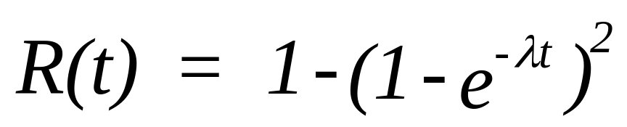
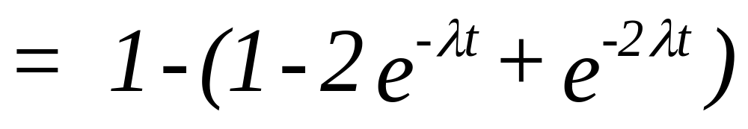
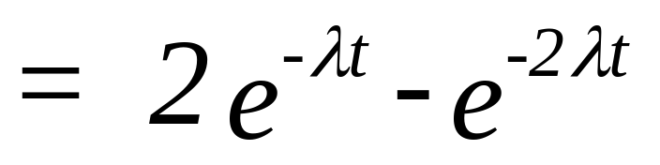
Redundancy
2 identical components with CFR
Chapter 3
Notes:
Components in a system may be related to one another in a serial fashion as discussed earlier or in parallel or redundant fashion. Redundancy will also be discussed further in Chapter 5. If two components are redundant, both must fail for the system to fail. R(t) is found by taking 1 – the probability that both components fail by time t. Why can we do this?

Slide 28
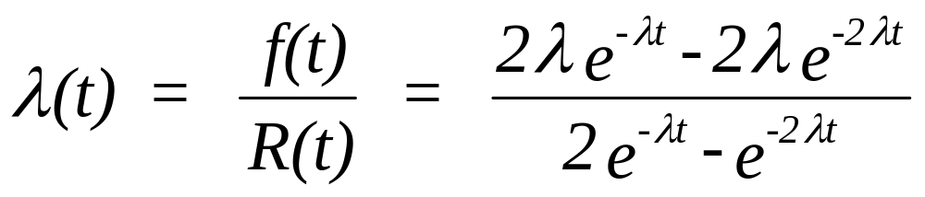
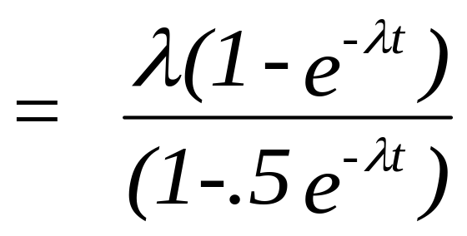
Redundancy - Hazard Rate Function
Not a CFR process!
Chapter 3
Notes:
For a system consisting of two redundant and CFR components, the hazard rate function is no longer CFR. Observing the value of the hazard rate function as t get larger, it can be seen that the failure rate approaches a constant that is equal to common failure rate of the two components. What a neat result!

Slide 29
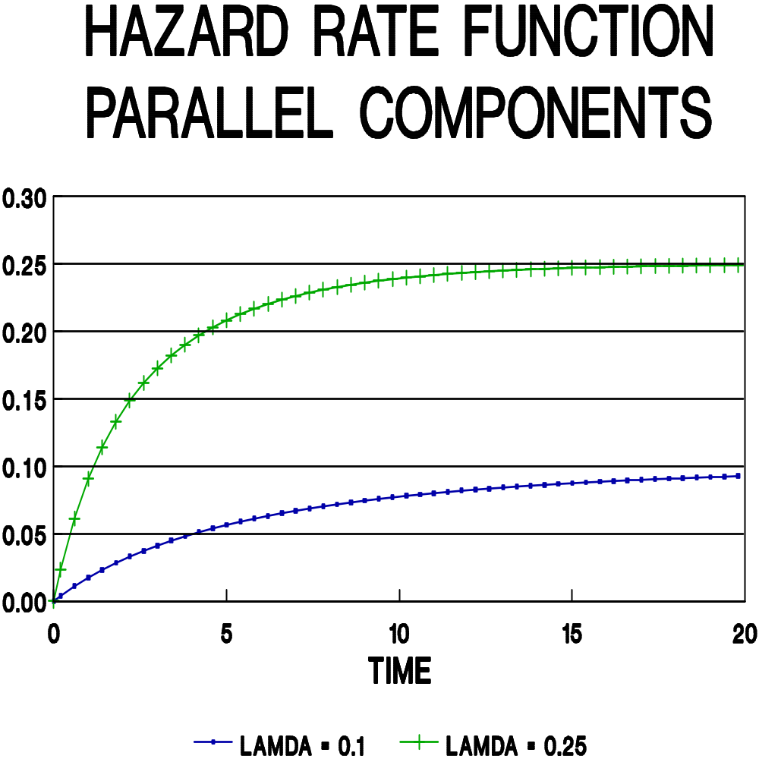
Chapter 3
Notes:
Here is that result shown graphically for two different lambda values.

Slide 30
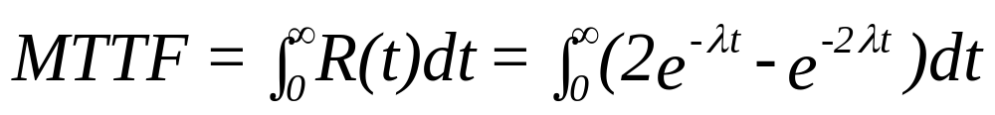
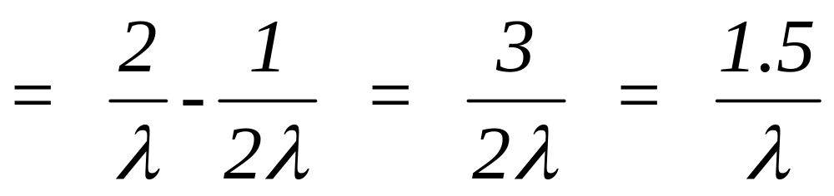
Redundancy, CFR & MTTF
Chapter 3
Notes:
The MTTF of a system composed of two identical and CFR components is found by integrating the system reliability function. The MTTF of this redundant system is 1.5 times the MTTF of each of components.

Slide 31
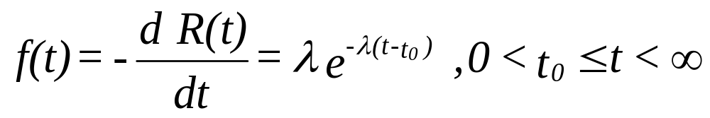
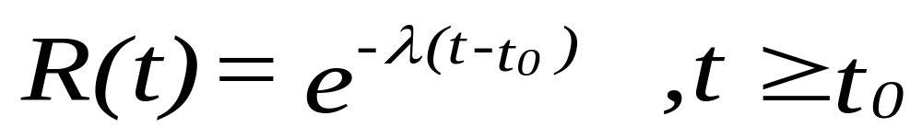
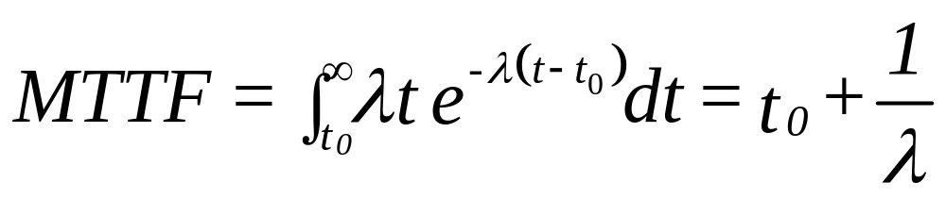
Two-parameter Exponential
Chapter 3
Notes:
Occasionally, a situation is encountered in which no failures can occur until some time t₀ has elapsed. This time is referred to as the minimum life. For the exponential distribution that minimum life becomes a second parameter, a location parameter. Its effect to shift the distribution by the amount t₀ on t-axis. This causes the MTTF and median time to failure to shift as well; but not the variance. Why?

Slide 32
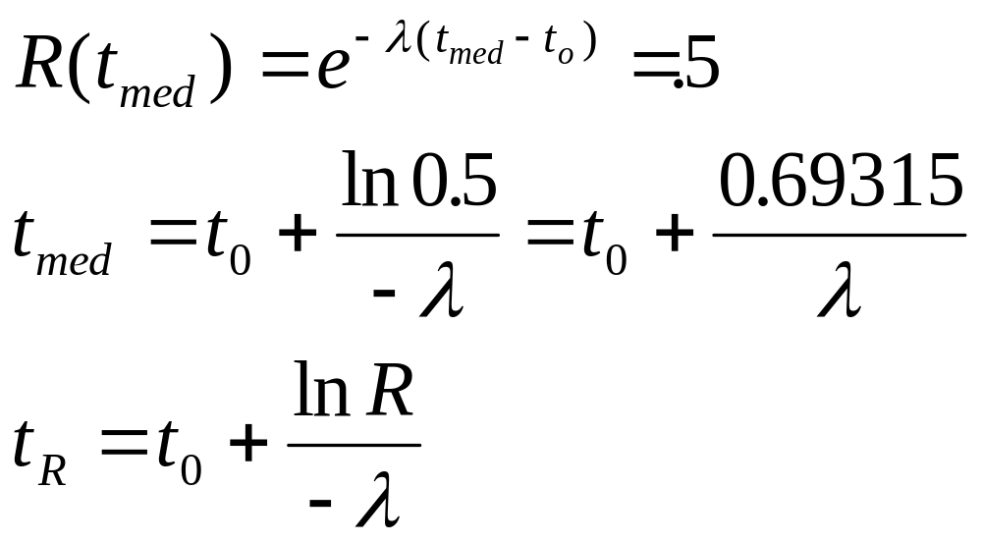
More 2-parameter Exponential
Note that the variance does not change and the mode occurs at t₀.
Chapter 3
Notes:
Some more on the two-parameter exponential.

Slide 33

Example CFR Model
A certain type of surge protector is observed to fail at the constant rate of .0005 failures per day. Find:
a. The MTTF, median, and the standard deviation.
b. Find the reliability during the first year; the second year; the second year given it has survived the first year.
c. The 90% design life.
Chapter 3
Notes:
The inevitable student exercise.

Slide 34
Example - solution
a. MTTF = 1/.0005 = 2000 days (5.5 yr.)
Std Dev = 2000 days
t_{med} = 2000 x .69315 = 1386.3 days (3.8 yr.)
b. R(365) = e^{- 365 x .0005} = .833
R(730) = e^{-730 x .0005} = .694
R(365|365) = R(365) = .833
c. t_{.90} = - 2000 ln .90 = 210 days (7 mo.)
Chapter 3
Notes:
Check your answers. Contact your instructor if things are not going well.

Slide 35

Bonus Round - Return Period
“An asteroid 2/3 of a mile across smashing into the Earth at a high speed which would cause a blast with the power of thousands of hydrogen bombs could happen within the next 300,000 years.”
- Dave Morrison (NASA)
Let P = the return period, the mean length of time between
a failure event. Then
R(t) = e^{- t / P} = e^{- t /300,000 yrs}
and R(70 yr.) = e^{- 70 / 300,000} = .9997667
Chapter 3

Slide 36

The End
Our next assignment will be in Chapter 4. First, however, you will want work the problems identified for chapter 3.
Chapter 3
Notes:
We look forward to the next Chapter.

